Slide 1
Vector Spaces
VECTOR SPACES AND SUBSPACES
© 2012 Pearson Education, Inc.

Slide 2




VECTOR SPACES AND SUBSPACES
Definition: A vector space is a nonempty set V of objects, called vectors, on which are defined two operations, called addition and multiplication by scalars (real numbers), subject to the ten axioms (or rules) listed below. The axioms must hold for all vectors u, v, and w in V and for all scalars c and d.
    The sum of u and v, denoted by , is in V.
    .
    .
    There is a zero vector 0 in V such that
    .
© 2012 Pearson Education, Inc.
Slide 4.1- <number>

Slide 3





VECTOR SPACES AND SUBSPACES
    For each u in V, there is a vector in V such that .
    The scalar multiple of u by c, denoted by cu, is in V.
    .
    .
    .
    .
© 2012 Pearson Education, Inc.
Slide 4.1- <number>

Slide 4
VECTOR SPACES AND SUBSPACES
Example 1. The space of all 3x3 matrices is a vector space. The space of all matrices is not a vector space.
© 2012 Pearson Education, Inc.
Slide 4.1- <number>

Slide 5
SUBSPACES
Definition: A subspace of a vector space V is a subset H of V that has three properties:
    The zero vector of V is in H.
    H is closed under vector addition. That is, for each u and v in H, the sum is in H.
    H is closed under multiplication by scalars. That is, for each u in H and each scalar c, the vector cu is in H.
© 2012 Pearson Education, Inc.
Slide 4.1- <number>

Slide 6
SUBSPACES
Properties (a), (b), and (c) guarantee that a subspace H of V is itself a vector space, under the vector space operations already defined in V.
Every subspace is a vector space.
Conversely, every vector space is a subspace (of itself and possibly of other larger spaces).
© 2012 Pearson Education, Inc.
Slide 4.1- <number>

Slide 7
Example 1. The space of all 3x3 upper triangular matrices is a subspace. The space of all matrices with integer entries is not.
© 2012 Pearson Education, Inc.
Slide 4.1- <number>

Slide 8
A SUBSPACE SPANNED BY A SET
The set consisting of only the zero vector in a vector space V is a subspace of V, called the zero subspace and written as {0}.
As the term linear combination refers to any sum of scalar multiples of vectors, and Span {v₁,…,v_{p}} denotes the set of all vectors that can be written as linear combinations of v₁,…,v_{p}.
© 2012 Pearson Education, Inc.
Slide 4.1- <number>

Slide 9
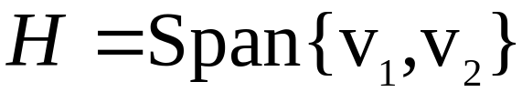
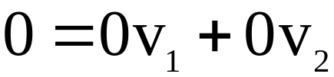
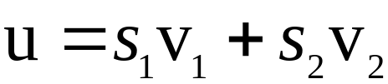
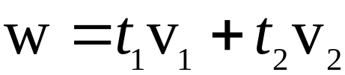
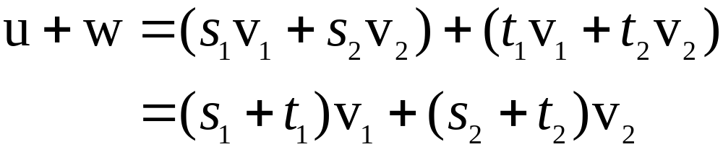
A SUBSPACE SPANNED BY A SET
Example 2: Given v₁ and v₂ in a vector space V, let
. Show that H is a subspace of V.
Solution: The zero vector is in H, since .
To show that H is closed under vector addition, take two arbitrary vectors in H, say,
and .
By Axioms 2, 3, and 8 for the vector space V,
© 2012 Pearson Education, Inc.
Slide 4.1- <number>

Slide 10
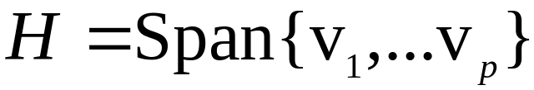
A SUBSPACE SPANNED BY A SET
Theorem 1: If v₁,…,v_{p} are in a vector space V, then Span {v₁,…,v_{p}} is a subspace of V.
We call Span {v₁,…,v_{p}} the subspace spanned (or generated) by {v₁,…,v_{p}}.
Give any subspace H of V, a spanning (or generating) set for H is a set {v₁,…,v_{p}} in H such that
.
© 2012 Pearson Education, Inc.
Slide 4.1- <number>

Slide 11
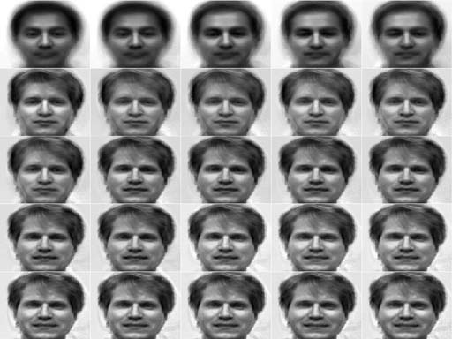
Eigenfaces
© 2012 Pearson Education, Inc.
Slide 4.1- <number>

Slide 12



NULL SPACE OF A MATRIX
Definition: The null space of an matrix A, written as Nul A, is the set of all solutions of the homogeneous equation . In set notation,
.
Theorem 2: The null space of an matrix A is a subspace of . Equivalently, the set of all solutions to a system of m homogeneous linear equations in n unknowns is a subspace of .
Proof: Nul A is a subset of because A has n columns.
We need to show that Nul A satisfies the three properties of a subspace.
© 2012 Pearson Education, Inc.
Slide 4.2- <number>

Slide 13
NULL SPACE OF A MATRIX
An Explicit Description of Nul A
There is no obvious relation between vectors in Nul A and the entries in A.
We say that Nul A is defined implicitly, because it is defined by a condition that must be checked.
© 2012 Pearson Education, Inc.
Slide 4.2- <number>

Slide 14
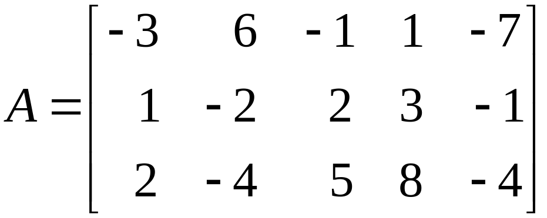
NULL SPACE OF A MATRIX
No explicit list or description of the elements in Nul A is given.
Solving the equation amounts to producing an explicit description of Nul A.
Example 1: Find a spanning set for the null space of the matrix
.
© 2012 Pearson Education, Inc.
Slide 4.2- <number>

Slide 15
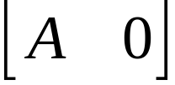
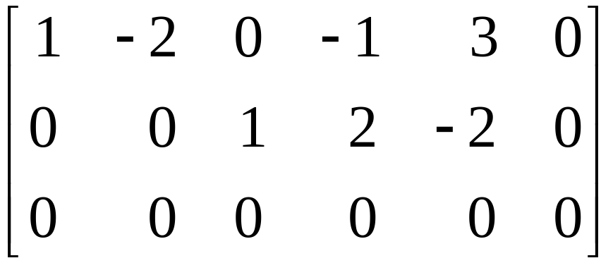
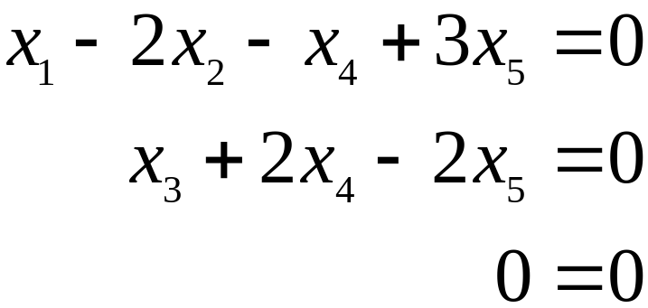
NULL SPACE OF A MATRIX
Solution: The first step is to find the general solution of in terms of free variables.
Row reduce the augmented matrix to reduce echelon form in order to write the basic variables in terms of the free variables:
,
© 2012 Pearson Education, Inc.
Slide 4.2- <number>

Slide 16
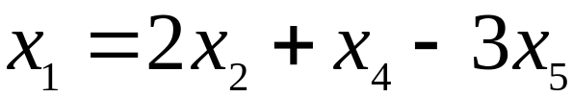
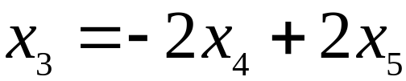
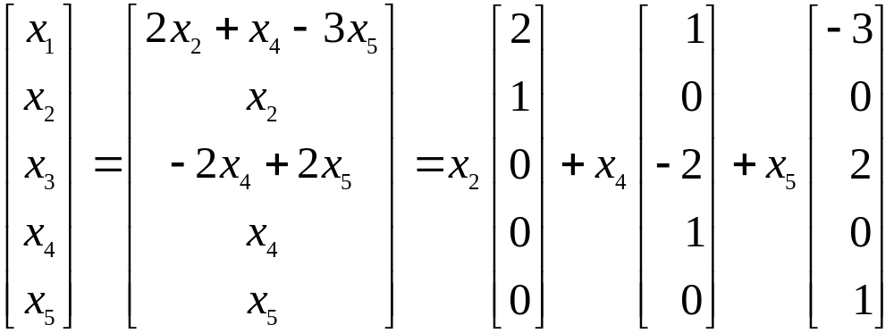
NULL SPACE OF A MATRIX
The general solution is ,
, with x₂, x₄, and x₅ free.
Next, decompose the vector giving the general solution into a linear combination of vectors where the weights are the free variables. That is,
u
v
w
© 2012 Pearson Education, Inc.
Slide 4.2- <number>

Slide 17
NULL SPACE OF A MATRIX
    The spanning set produced by the method in Example (1) is automatically linearly independent because the free variables are the weights on the spanning vectors.
    When Nul A contains nonzero vectors, the number of vectors in the spanning set for Nul A equals the number of free variables in the equation .
© 2012 Pearson Education, Inc.
Slide 4.2- <number>

Slide 18
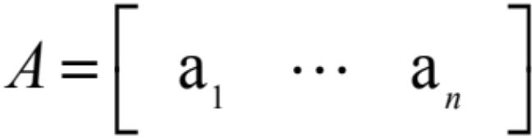
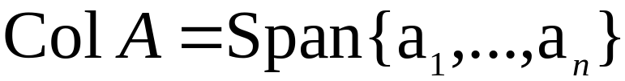

COLUMN SPACE OF A MATRIX
Definition: The column space of an matrix A, written as Col A, is the set of all linear combinations of the columns of A. If , then
.
Theorem 3: The column space of an matrix A is a subspace of .
© 2012 Pearson Education, Inc.
Slide 4.2- <number>

Slide 19


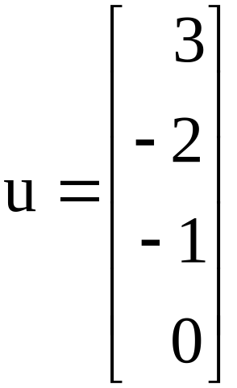
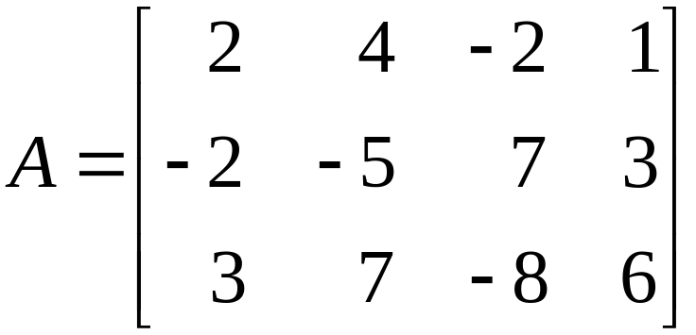
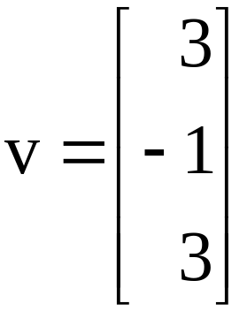
COLUMN SPACE OF A MATRIX
The notation Ax for vectors in Col A also shows that Col A is the range of the linear transformation .
The column space of an matrix A is all of if and only if the equation has a solution for each b in .
Example 2: Let ,
and .
© 2012 Pearson Education, Inc.
Slide 4.2- <number>

Slide 20
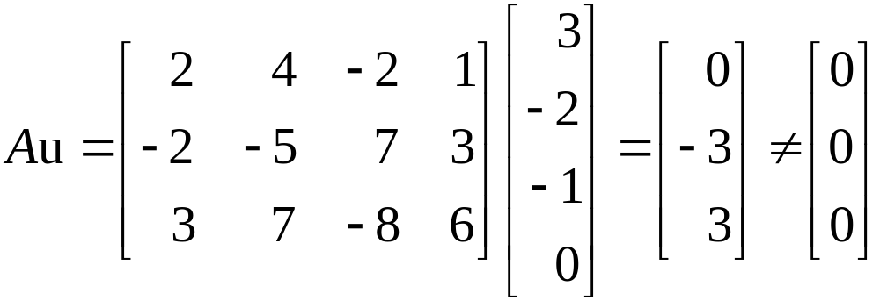
COLUMN SPACE OF A MATRIX
    Determine if u is in Nul A. Could u be in Col A?
    Determine if v is in Col A. Could v be in Nul A?
Solution:
    An explicit description of Nul A is not needed here. Simply compute the product Au.
© 2012 Pearson Education, Inc.
Slide 4.2- <number>

Slide 21


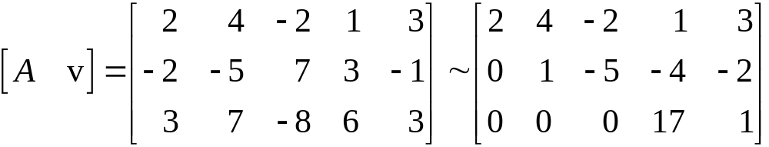

COLUMN SPACE OF A MATRIX
u is not a solution of , so u is not in Nul A.
Also, with four entries, u could not possibly be in Col A, since Col A is a subspace of .
    Reduce to an echelon form.
      The equation is consistent, so v is in Col A.
© 2012 Pearson Education, Inc.
Slide 4.2- <number>

Slide 22



KERNEL AND RANGE OF A LINEAR TRANSFORMATION
      With only three entries, v could not possibly be in Nul A, since Nul A is a subspace of .
Subspaces of vector spaces other than are often described in terms of a linear transformation instead of a matrix.
Definition: A linear transformation T from a vector space V into a vector space W is a rule that assigns to each vector x in V a unique vector T (x) in W, such that
    for all u, v in V, and
    for all u in V and all scalars c.
© 2012 Pearson Education, Inc.
Slide 4.2- <number>

Slide 23

KERNEL AND RANGE OF A LINEAR TRANSFORMATION
The kernel (or null space) of such a T is the set of all u in V such that (the zero vector in W ).
The range of T is the set of all vectors in W of the form T (x) for some x in V.
The kernel of T is a subspace of V.
The range of T is a subspace of W.
© 2012 Pearson Education, Inc.
Slide 4.2- <number>

Slide 24


CONTRAST BETWEEN NUL A AND COL A FOR AN
MATRIX A
Nul A | Col A
Nul A is a subspace of . | Col A is a subspace of .
Nul A is implicitly defined; i.e., you are given only a condition that vectors in Nul A must satisfy. | Col A is explicitly defined; i.e., you are told how to build vectors in Col A.
© 2012 Pearson Education, Inc.
Slide 4.2- <number>

Slide 25


CONTRAST BETWEEN NUL A AND COL A FOR AN
MATRIX A
It takes time to find vectors in Nul A. Row operations on are required. | It is easy to find vectors in Col A. The columns of a are displayed; others are formed from them.
There is no obvious relation between Nul A and the entries in A. | There is an obvious relation between Col A and the entries in A, since each column of A is in Col A.
© 2012 Pearson Education, Inc.
Slide 4.2- <number>

Slide 26


CONTRAST BETWEEN NUL A AND COL A FOR AN
MATRIX A
A typical vector v in Nul A has the property that . | A typical vector v in Col A has the property that the equation is consistent.
Given a specific vector v, it is easy to tell if v is in Nul A. Just compare Av. | Given a specific vector v, it may take time to tell if v is in Col A. Row operations on are required.
© 2012 Pearson Education, Inc.
Slide 4.2- <number>

Slide 27






CONTRAST BETWEEN NUL A AND COL A FOR AN
MATRIX A
Nul if and only if the equation has only the trivial solution. | Col if and only if the equation has a solution for every b in .
Nul if and only if the linear transformation is one-to-one. | Col if and only if the linear transformation maps onto .
© 2012 Pearson Education, Inc.
Slide 4.2- <number>

